Slide 1
Distributed averaging consensus
Lin Xiao and Stephen Boyd, “Systems & Control Letters,” 53 (2004) 65 – 78.
Consider a network (connected graph) G=(V,E)
Each vertex i holds an initial scalar value x_{i}(0) in R, and x(0)=(x₁(0),…, x_{n}(0))
Two vertices can communicate with each other, if and only if they are neighbors.
The problem is to compute the average of the initial values, ,via a distributed algorithm

Slide 2
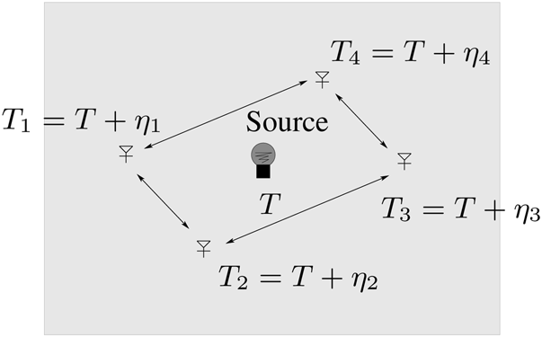
Motivation
Sensor networks (measuring temperature)
A flock of flying birds

Slide 3
Distributed linear iterations
Constant edge weights
In matrix form
L=D-A is the Laplacian of the graph

Slide 4
Distributed linear iterations
W=I- L
The vector (1,1,…,1) is an eigenvector with eigenvalue 0 of the Laplacain L.
L is symmetric for an undirected graph
W is a doubly stochastic matrix, i.e., all the row sums and column sums are all equal to 1.
If W is a nonnegative matrix, then W can be viewed as the probability transition matrix of a Markov chain and
where is a matrix with all its elements being 1.

Slide 5
Condition for convergence
As
The condition for W to be a nonnegative matrix,
k_{i} is the degree of vertex i
Distributed linear iteration is guaranteed to converge if

Slide 6
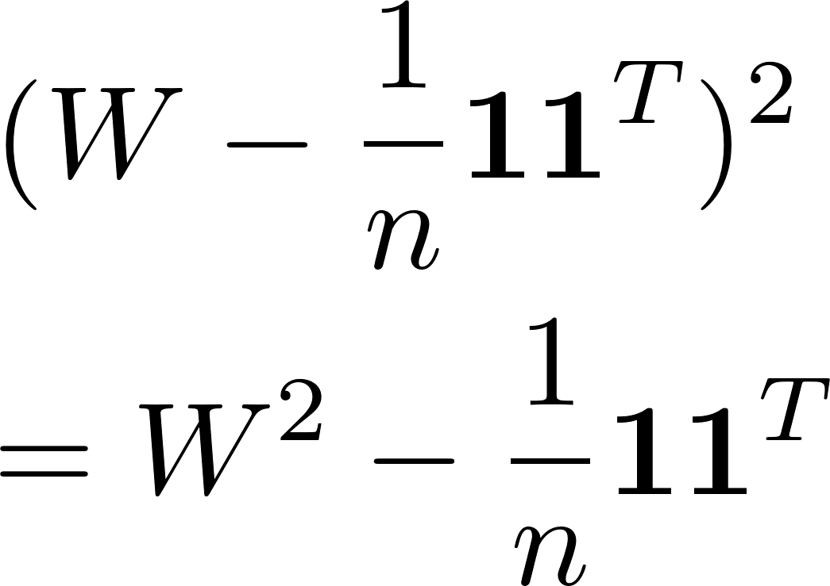
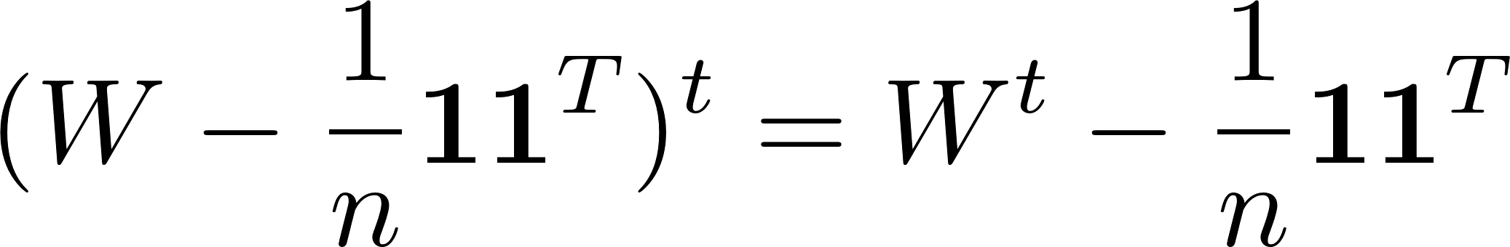
Rate of convergence
Rate of convergence is decided by the spectral radius of the matrix
W has the largest eigenvalue 1 for the eigenvector 1^{T}=(1,1,…1)
Then prove this by induction on t

Slide 7
Rate of convergence
The spectral radius of the matrix
is simply the maximum of the absolute value of the second largest eigenvalue and the absolute value of the smallest eigenvalue of W.
Note that W=I- L. Thus,
The spectral radius of the matrix
is
Where λ_{i}(L) is the ith largest eigenvalue of L

Slide 8
The fastest converence

